Slide 1

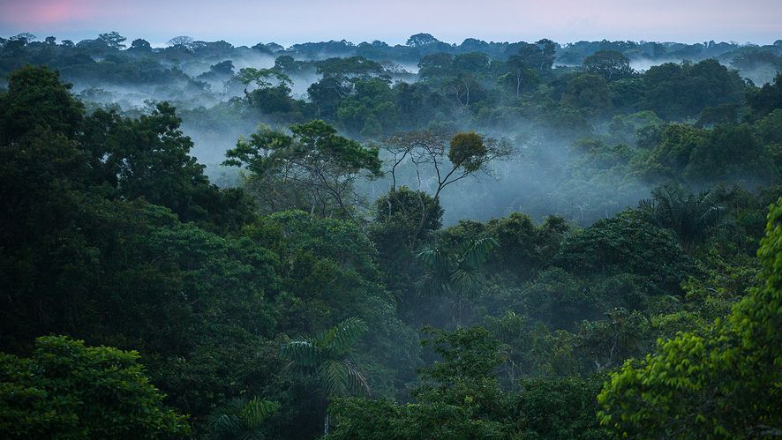
Amazon Rainforest
The largest tropical rainforest in the world, the Amazon jungle spreads over 6.7 million km² and has been the life-giving home to countless species for millions of years. People have always been a part of the rich biodiversity of Amazonia as it is the ancestral home to more than one million native Indians.
Amazon Rainforest
The largest tropical rainforest in the world, the Amazon jungle spreads over 5.5 million km² and has been the life-giving home to countless species for millions of years. People have always been a part of the rich biodiversity of Amazonia as it is the ancestral home to more than one million native Indians.
Amazon Rainforest

Slide 2

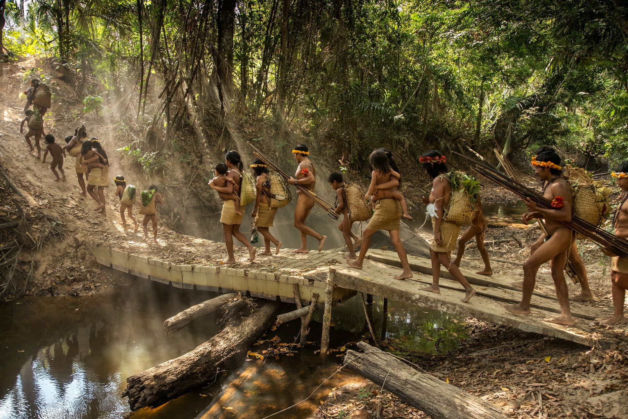
Tribes of Amazon Rainforest:
The Amazon Rainforest has been home to ancient tribes like the Yanomami, Kayapo, and Ashaninka for thousands of years. These indigenous peoples have unique cultures, relying on the rainforest for sustenance and spirituality. They face challenges from external forces, but many resist to protect their land and culture. Preserving these tribes is crucial for maintaining cultural diversity and the health of the Amazon Rainforest.
Amazon Rainforest
The largest tropical rainforest in the world, the Amazon jungle spreads over 5.5 million km² and has been the life-giving home to countless species for millions of years. People have always been a part of the rich biodiversity of Amazonia as it is the ancestral home to more than one million native Indians.
Amazon Rainforest

Slide 3

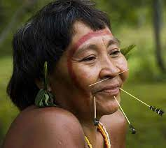
The Yanomami Tribe:
The Yanomami tribe, dwelling in the Amazon across Brazil and Venezuela, exhibits a culture rooted in communal living and egalitarian social structures. Relying on hunting, gathering, and slash-and-burn agriculture, their diet includes game, fish, fruits, and cultivated crops like plantains and cassava.
Traditional Yanomami clothing is minimal, often made from natural materials, with body painting and feather adornments. While practical attire suits their rainforest environment, some may adopt Western clothing in certain contexts.
Challenges include external threats like mining and encroachment, disrupting their traditional lifestyle and posing health risks. The Yanomami strive to protect their land, maintain sustainable practices, and preserve their cultural identity amid modern influences.
The Yanomami Tribe:
The Yanomami tribe is an indigenous group living in the Amazon Rainforest, primarily in Brazil and Venezuela. Known for their unique semi-nomadic lifestyle, the Yanomami rely on traditional hunting, fishing, and agriculture for sustenance. They are recognized for their communal living, circular villages, and shamanistic spiritual beliefs. Unfortunately, the Yanomami face threats from encroachment, diseases introduced by outsiders, and illegal mining activities in their territory. Efforts are being made to protect their rights, preserve their cultural heritage, and safeguard the Amazon Rainforest they call home
Tribes of Amazon Rainforest:
The Amazon Rainforest has been home to ancient tribes like the Yanomami, Kayapo, and Ashaninka for thousands of years. These indigenous peoples have unique cultures, relying on the rainforest for sustenance and spirituality. They face challenges from external forces, but many resist to protect their land and culture. Preserving these tribes is crucial for maintaining cultural diversity and the health of the Amazon Rainforest.
Amazon Rainforest
The largest tropical rainforest in the world, the Amazon jungle spreads over 6.7 million km² and has been the life-giving home to countless species for millions of years. People have always been a part of the rich biodiversity of Amazonia as it is the ancestral home to more than one million native Indians.
Amazon Rainforest
The largest tropical rainforest in the world, the Amazon jungle spreads over 5.5 million km² and has been the life-giving home to countless species for millions of years. People have always been a part of the rich biodiversity of Amazonia as it is the ancestral home to more than one million native Indians.

Slide 4
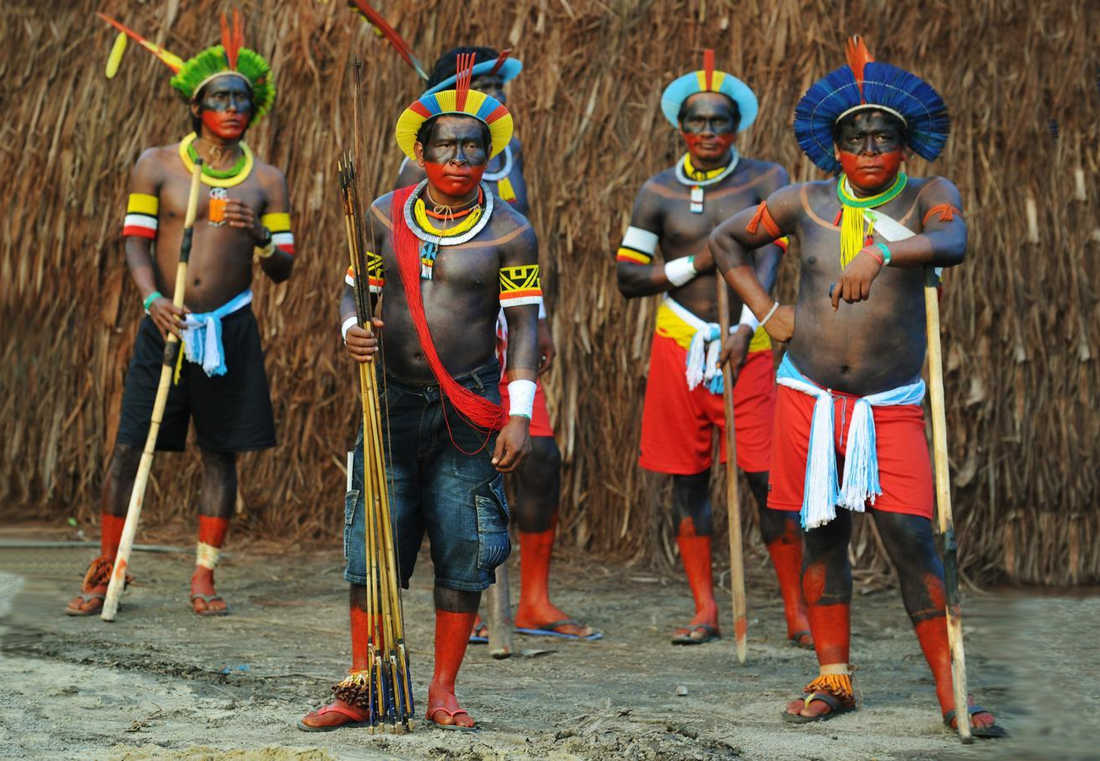
The Kayapo tribe:
The Kayapo tribe, indigenous to the Amazon rainforest in Brazil, has a rich culture rooted in communal living. Their traditional lifestyle involves subsistence farming (slash-and-burn agriculture), hunting, and gathering. Kayapo clothing features traditional elements like body paint, feathers, and plant fiber skirts, but some also adopt Western attire. Challenges include deforestation and threats to land rights, impacting their sustainable practices and spiritual connection to nature. The tribe faces ongoing struggles to maintain their traditional way of life amid external pressures.
The Yanomami Tribe:
The Yanomami tribe, dwelling in the Amazon across Brazil and Venezuela, exhibits a culture rooted in communal living and egalitarian social structures. Relying on hunting, gathering, and slash-and-burn agriculture, their diet includes game, fish, fruits, and cultivated crops like plantains and cassava.
Traditional Yanomami clothing is minimal, often made from natural materials, with body painting and feather adornments. While practical attire suits their rainforest environment, some may adopt Western clothing in certain contexts.
Challenges include external threats like mining and encroachment, disrupting their traditional lifestyle and posing health risks. The Yanomami strive to protect their land, maintain sustainable practices, and preserve their cultural identity amid modern influences.
Tribes of Amazon Rainforest:
The Amazon Rainforest has been home to ancient tribes like the Yanomami, Kayapo, and Ashaninka for thousands of years. These indigenous peoples have unique cultures, relying on the rainforest for sustenance and spirituality. They face challenges from external forces, but many resist to protect their land and culture. Preserving these tribes is crucial for maintaining cultural diversity and the health of the Amazon Rainforest.

Slide 5
The Kayapo tribe:
The Kayapo tribe, indigenous to the Amazon rainforest in Brazil, has a rich culture rooted in communal living. Their traditional lifestyle involves subsistence farming (slash-and-burn agriculture), hunting, and gathering. Kayapo clothing features traditional elements like body paint, feathers, and plant fiber skirts, but some also adopt Western attire. Challenges include deforestation and threats to land rights, impacting their sustainable practices and spiritual connection to nature. The tribe faces ongoing struggles to maintain their traditional way of life amid external pressures.
The Yanomami Tribe:
The Yanomami tribe, dwelling in the Amazon across Brazil and Venezuela, exhibits a culture rooted in communal living and egalitarian social structures. Relying on hunting, gathering, and slash-and-burn agriculture, their diet includes game, fish, fruits, and cultivated crops like plantains and cassava.
Traditional Yanomami clothing is minimal, often made from natural materials, with body painting and feather adornments. While practical attire suits their rainforest environment, some may adopt Western clothing in certain contexts.
Challenges include external threats like mining and encroachment, disrupting their traditional lifestyle and posing health risks. The Yanomami strive to protect their land, maintain sustainable practices, and preserve their cultural identity amid modern influences.
Tribes of Amazon Rainforest:
The Amazon Rainforest has been home to ancient tribes like the Yanomami, Kayapo, and Ashaninka for thousands of years. These indigenous peoples have unique cultures, relying on the rainforest for sustenance and spirituality. They face challenges from external forces, but many resist to protect their land and culture. Preserving these tribes is crucial for maintaining cultural diversity and the health of the Amazon Rainforest.

Slide 6
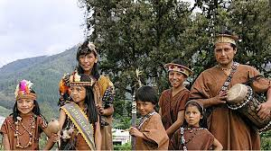
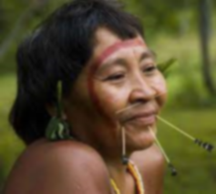
The Yanomami Tribe:
The Yanomami tribe is an indigenous group living in the Amazon Rainforest, primarily in Brazil and Venezuela. Known for their unique semi-nomadic lifestyle, the Yanomami rely on traditional hunting, fishing, and agriculture for sustenance. They are recognized for their communal living, circular villages, and shamanistic spiritual beliefs. Unfortunately, the Yanomami face threats from encroachment, diseases introduced by outsiders, and illegal mining activities in their territory. Efforts are being made to protect their rights, preserve their cultural heritage, and safeguard the Amazon Rainforest they call home
The Ashaninka Tribe:
The Ashaninka tribe, native to the Amazon, sustains its culture through communal living, traditional rituals, and a deep spiritual connection to nature. They practice subsistence farming, cultivating crops like cassava and maize, supplemented by hunting and fishing. Traditional clothing includes natural fibers and decorative elements, adapting to Western attire in certain contexts. Swidden agriculture is a key practice, though external pressures pose challenges. Land rights and conservation are ongoing concerns as the Ashaninka strive to preserve their cultural heritage amid modern influences.
The Kayapo tribe:
The Kayapo tribe, indigenous to the Amazon rainforest in Brazil, has a rich culture rooted in communal living. Their traditional lifestyle involves subsistence farming (slash-and-burn agriculture), hunting, and gathering. Kayapo clothing features traditional elements like body paint, feathers, and plant fiber skirts, but some also adopt Western attire. Challenges include deforestation and threats to land rights, impacting their sustainable practices and spiritual connection to nature. The tribe faces ongoing struggles to maintain their traditional way of life amid external pressures.

Slide 7
Conclusion
From the presentation we understand the tribes of the Amazon Rainforest, such as the Yanomami, Kayapo, and Ashaninka, embody the rich tapestry of indigenous cultures that have thrived in harmony with the rainforest for centuries. These communities serve as stewards of the environment, with unique knowledge of sustainable practices and a profound spiritual connection to nature. However, they face ongoing challenges from external forces, threatening their lands and traditional ways of life.
Preserving the rights, cultures, and environments of these tribes is not only a matter of justice but also essential for the global effort to conserve biodiversity and mitigate climate change. Recognizing the value of indigenous wisdom and supporting their autonomy is crucial for the well-being of both these communities and the broader ecosystem of the Amazon Rainforest. As we navigate the complex issues surrounding the rainforest, it is imperative to work collaboratively to ensure the survival of these ancient tribes and the invaluable ecosystems they call home.
The Ashaninka Tribe:
The Ashaninka tribe, native to the Amazon, sustains its culture through communal living, traditional rituals, and a deep spiritual connection to nature. They practice subsistence farming, cultivating crops like cassava and maize, supplemented by hunting and fishing. Traditional clothing includes natural fibers and decorative elements, adapting to Western attire in certain contexts. Swidden agriculture is a key practice, though external pressures pose challenges. Land rights and conservation are ongoing concerns as the Ashaninka strive to preserve their cultural heritage amid modern influences.
The Kayapo tribe:
The Kayapo tribe is an indigenous group residing in the Amazon Rainforest. Hailing from Brazil, they have a rich culture deeply connected to the rainforest. The Kayapo are known for their vibrant traditional attire, intricate body painting, and unique ceremonies. They practice sustainable farming and hunting, emphasizing a harmonious relationship with nature. The tribe has been actively involved in environmental advocacy, resisting threats such as deforestation and advocating for the protection of their land and way of life.

Slide 8
Thank You
Any questions related to this topic is heartly welcomed!
Conclusion
From the presentation we understand the tribes of the Amazon Rainforest, such as the Yanomami, Kayapo, and Ashaninka, embody the rich tapestry of indigenous cultures that have thrived in harmony with the rainforest for centuries. These communities serve as stewards of the environment, with unique knowledge of sustainable practices and a profound spiritual connection to nature. However, they face ongoing challenges from external forces, threatening their lands and traditional ways of life.
Preserving the rights, cultures, and environments of these tribes is not only a matter of justice but also essential for the global effort to conserve biodiversity and mitigate climate change. Recognizing the value of indigenous wisdom and supporting their autonomy is crucial for the well-being of both these communities and the broader ecosystem of the Amazon Rainforest. As we navigate the complex issues surrounding the rainforest, it is imperative to work collaboratively to ensure the survival of these ancient tribes and the invaluable ecosystems they call home.
The Ashaninka Tribe:
The Ashaninka tribe, native to the Amazon, sustains its culture through communal living, traditional rituals, and a deep spiritual connection to nature. They practice subsistence farming, cultivating crops like cassava and maize, supplemented by hunting and fishing. Traditional clothing includes natural fibers and decorative elements, adapting to Western attire in certain contexts. Swidden agriculture is a key practice, though external pressures pose challenges. Land rights and conservation are ongoing concerns as the Ashaninka strive to preserve their cultural heritage amid modern influences.

Slide 9
Thank You
Any questions related to this topic is heartly welcomed!
Conclusion
From the presentation we understand the tribes of the Amazon Rainforest, such as the Yanomami, Kayapo, and Ashaninka, embody the rich tapestry of indigenous cultures that have thrived in harmony with the rainforest for centuries. These communities serve as stewards of the environment, with unique knowledge of sustainable practices and a profound spiritual connection to nature. However, they face ongoing challenges from external forces, threatening their lands and traditional ways of life.
Preserving the rights, cultures, and environments of these tribes is not only a matter of justice but also essential for the global effort to conserve biodiversity and mitigate climate change. Recognizing the value of indigenous wisdom and supporting their autonomy is crucial for the well-being of both these communities and the broader ecosystem of the Amazon Rainforest. As we navigate the complex issues surrounding the rainforest, it is imperative to work collaboratively to ensure the survival of these ancient tribes and the invaluable ecosystems they call home.

